Slide 1

P.I.E. - Pixel Image Editor
Project Overview
Contributors: Jacob Watters, Dustin Shaver, Nick Miller, Francesco Limoni, Omar Bitar

Slide 2








Tools
Language: Ruby
Gems (Libraries): FXRuby, Launchy
Version Control: Git/GitHub
Issue Tracking: GitHub
IDE: Eclipse, visual studio code, Aptana
Time Tracking: Excel, ATracker
UML: draw.io
Communication: Discord
Containerization: Docker

Slide 3
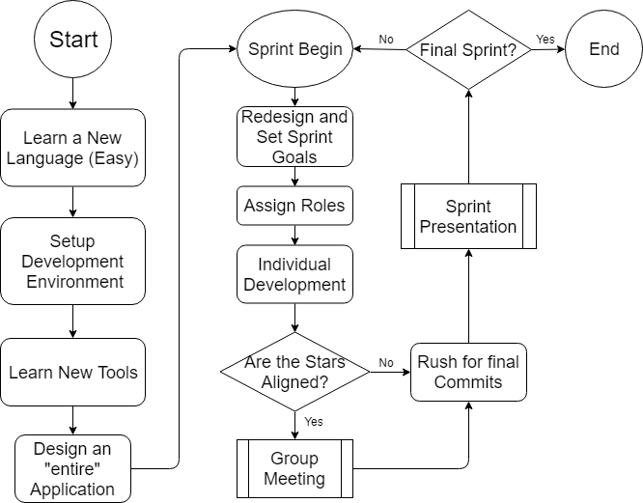
The Development Process
Product Management Framework: Agile
Daily Scrum
Bi-weekly Sprints
Roles: Product Owner, Scrum Master,
Developers, Customer

Slide 4
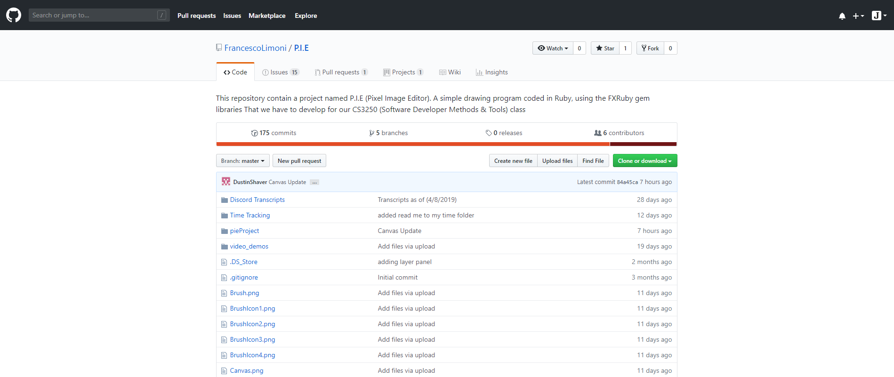
Git/GitHub
GitHub was used for version control and as a code repository
Each developer had their own branch
At the end of each sprint the branches would be merged into a master branch.
Repository Link: https://github.com/FrancescoLimoni/P.I.E

Slide 5
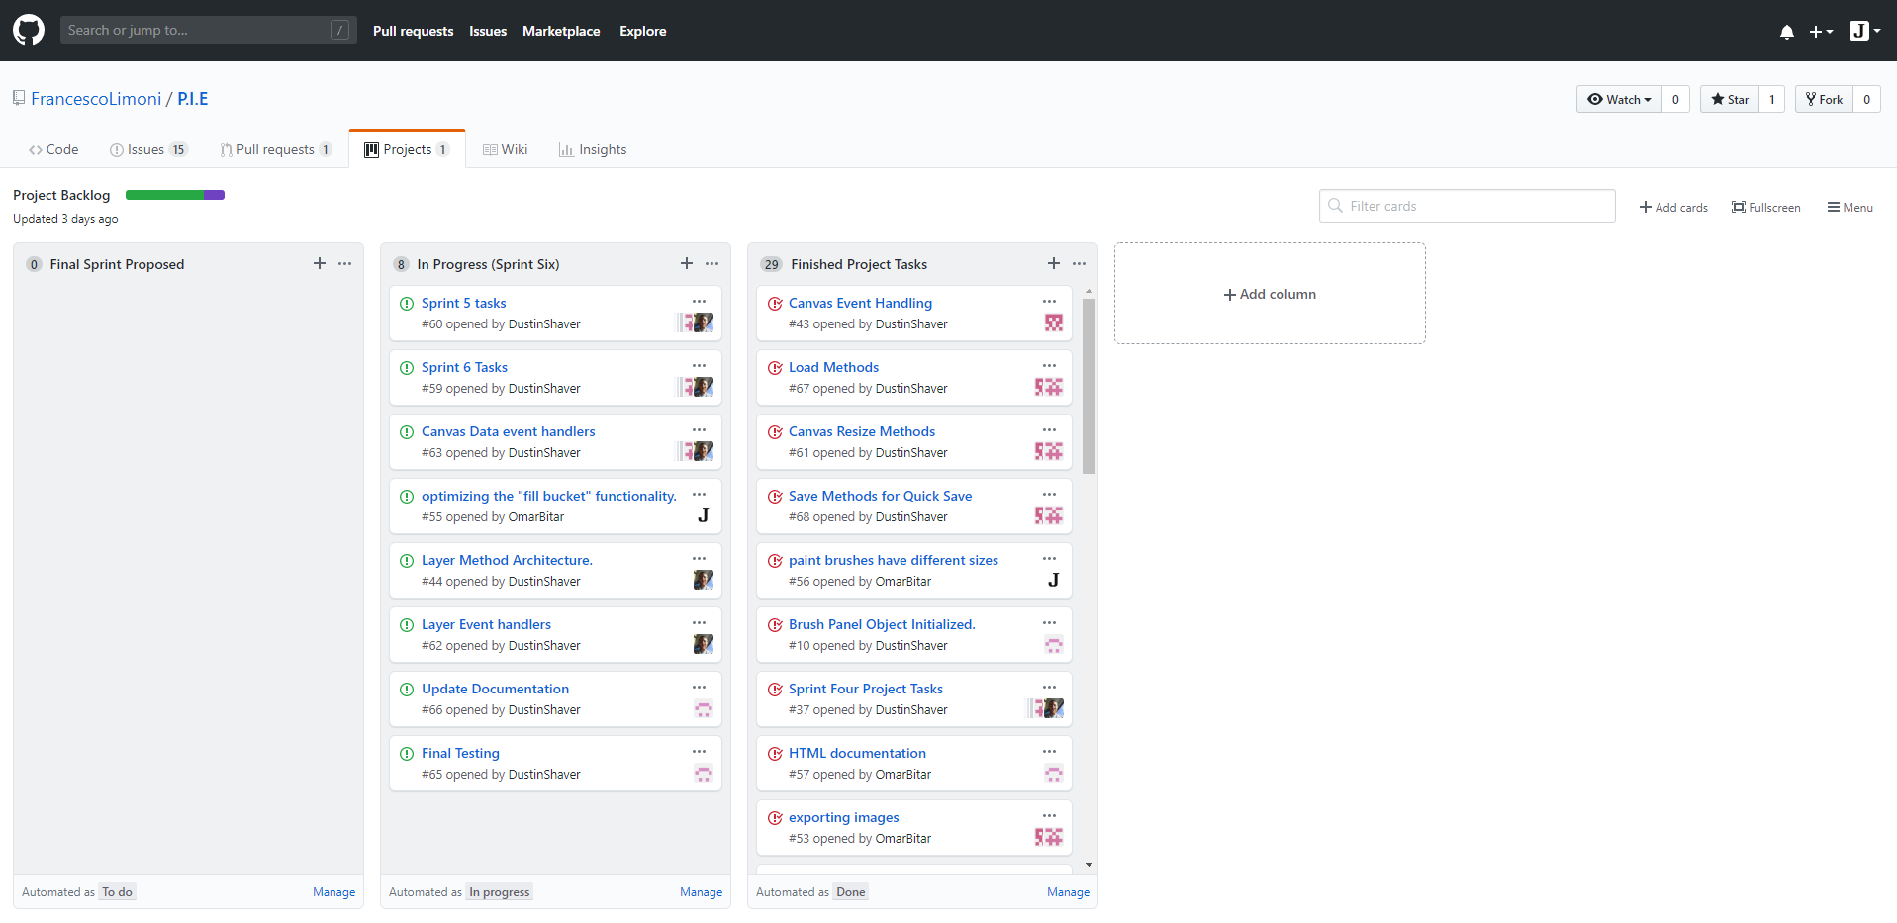
Issue Tracking
Issue Tracking done through GitHub

Slide 6
Container
Container made with Docker
Repository from the docker registry: sudo docker pull obitar/pie-app:v1
Run: sudo docker run --net=host --env="DISPLAY" --volume="$HOME/.Xauthority:/root/.Xauthority:rw" obitar/pie-app:v1
Link: https://hub.docker.com/r/obitar/pie-app

Slide 7
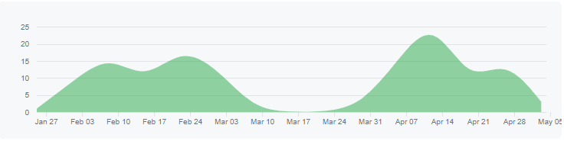
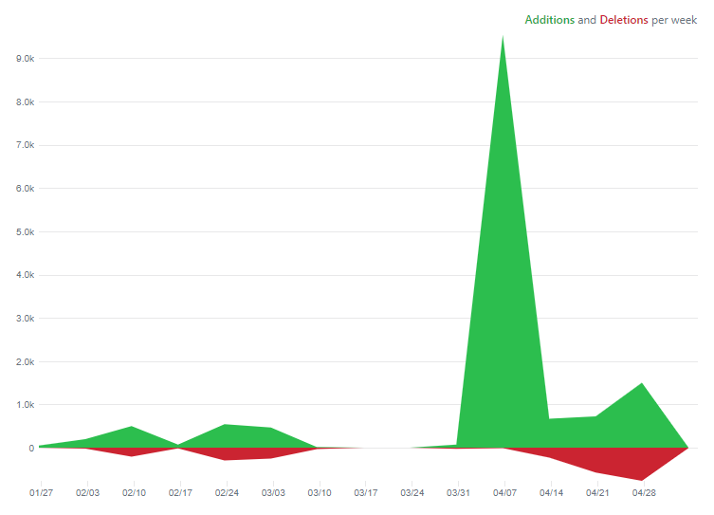
Project Velocity
Contributions to master
Code Frequency

Slide 8
What is P.I.E. And What Can It Do?
Pixel Image Editor, or P.I.E. for short, is a simple computer based graphics editing program that allows you to draw, change brush size and shape, change color, edit and hide multiple layers, save your work as a PNG file, and even load PNG images into the program.

Slide 9
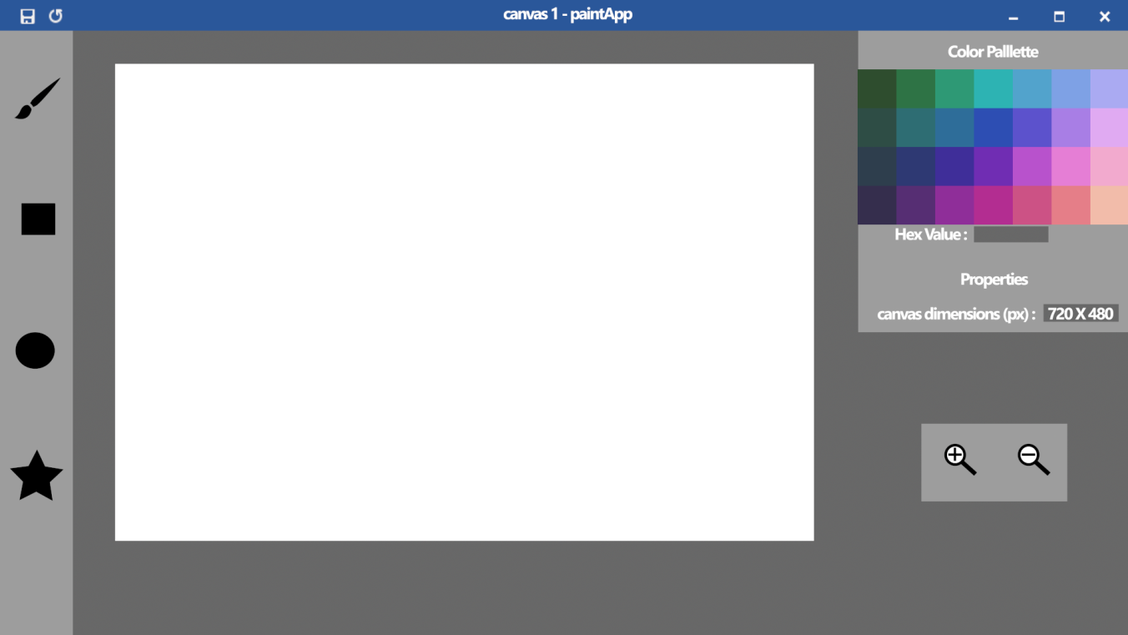
The Evolution of P.I.E
Concept Art
Original Idea of what we wanted the application to look like
P.I.E-Concept

Slide 10
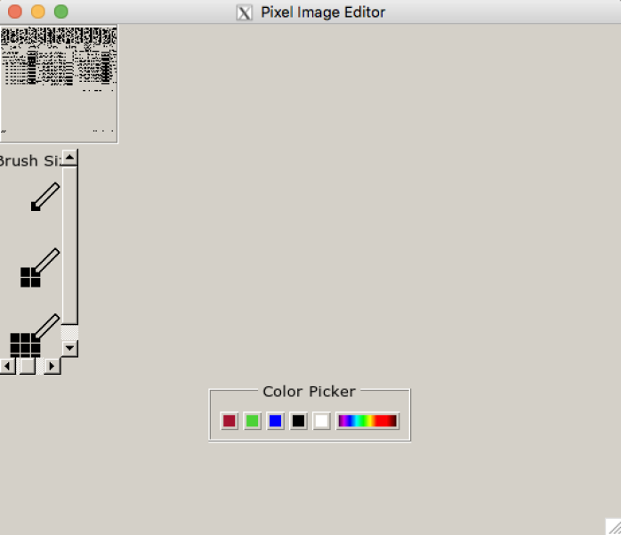
The Evolution of P.I.E
A Look at Sprint 1
Looked Bad
Nothing Worked
P.I.E-Sp1

Slide 11
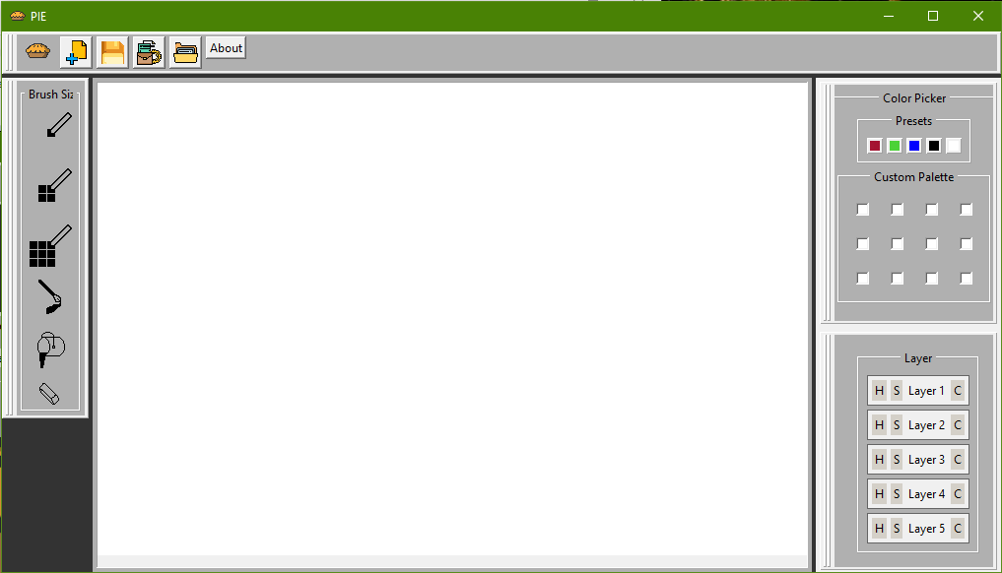
The Evolution of P.I.E
Final Product
A neat, simple, and fully functional graphics editing program.
P.I.E-Sp6

Slide 12
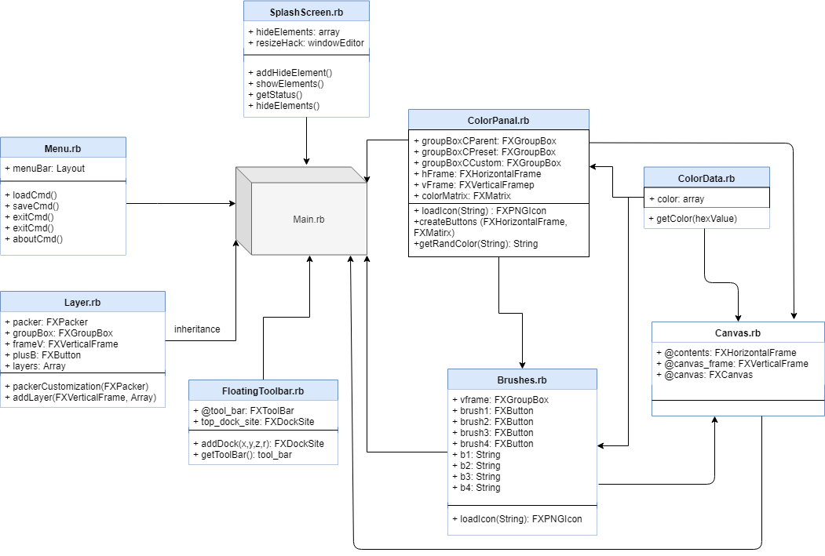
Program Structure

Slide 13
Demo. . .

